Slide 1

Fake Job Posting Detection using ML & Deep Learning
Milestone - 1: Summary
Milestone-2: Model Training, Optimization & Evaluation
Presented by: Uday Varma
Number: 0614

Slide 2
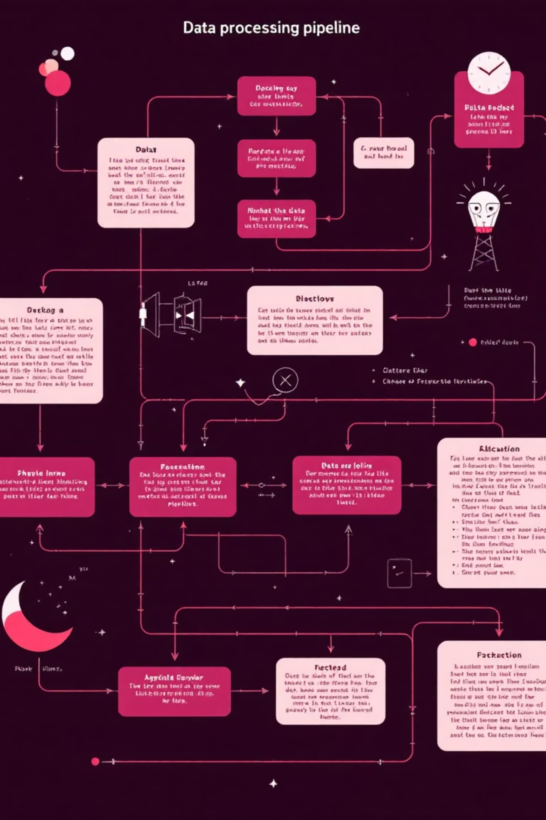
Quick Recap: Milestone-1 Achievements
In Milestone-1, we established a robust foundation by transforming raw job posting data into structured, machine-readable features ready for model training.
01
Data Loading & Exploration
Loaded the Kaggle Fake Job Postings Dataset and performed comprehensive exploratory data analysis to understand fraudulent posting patterns.
02
Text Normalization
Applied lowercase conversion, HTML tag removal, URL filtering, special character cleaning, and whitespace normalization to create a cleaned description column.
03
Feature Engineering
Extracted TF-IDF features with max_features=5000, converting text data into numerical representations that capture important patterns.
04
Data Preparation
Created train-test splits and saved preprocessing artifacts (tfidf_vectorizer.pkl, train_test_split.joblib) for seamless model training.

Slide 3


Milestone-2: Training & Optimization Goals
Milestone-2 focused on developing and comparing multiple machine learning approaches to identify fraudulent job postings with high accuracy and reliability.
Three Model Architectures
Rigorous Evaluation
Logistic Regression, Random Forest, and BiLSTM deep learning models trained and evaluated.
Cross-validation and comprehensive metric comparison to identify the best performing classifier.
Production-Ready Artifacts
Saved trained models, tokenizers, vectorizers, and performance metrics for deployment.

Slide 4
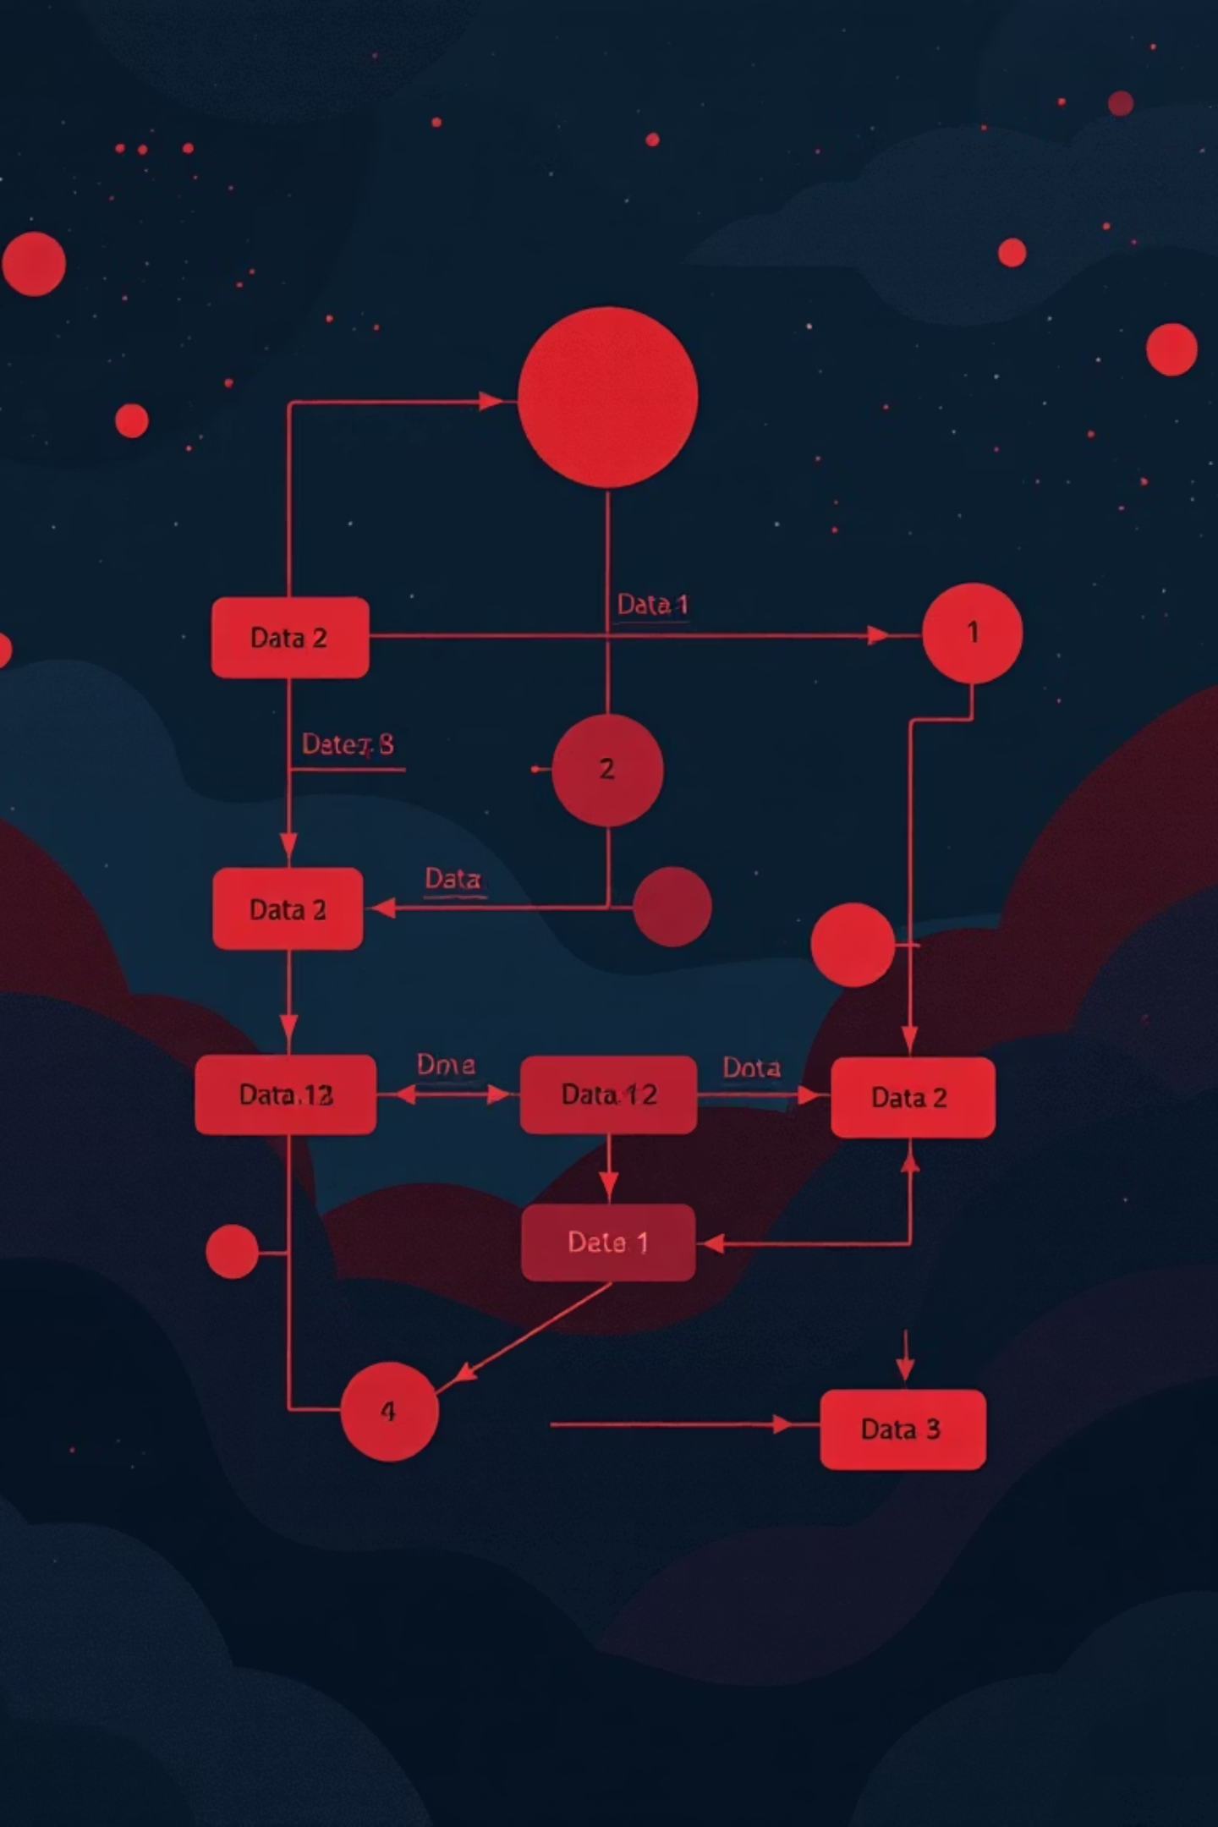
Logistic Regression: Training & Hyperparameter Tuning
Logistic Regression served as our baseline model, with careful attention to class imbalance through balanced class weights and systematic hyperparameter optimization.
1
Class Imbalance Handling
Applied balanced class weights to ensure the model doesn't bias toward the majority legitimate postings class.
2
Hyperparameter Grid
Tuned C values [0.01, 0.1, 1, 10], solvers [liblinear, lbfgs], and L2 penalty regularization.
3
Cross-Validation Strategy
Used GridSearchCV with 5-fold cross-validation, optimizing for F1 Score to balance precision and recall.
4
Best Configuration
Optimal parameters: C=10, penalty='l2', solver='liblinear'. Model saved as logreg_best.joblib.

Slide 5

Random Forest: Ensemble Learning Approach
Model Configuration
Random Forest leveraged the same TF-IDF features from Milestone-1, with extensive hyperparameter tuning across tree depth, number of estimators, and split criteria.
High Precision
Achieved exceptional precision (97.94%), indicating very few false positives when flagging fraudulent postings.
Lower Recall Trade-off
Recall of 54.91% revealed the model missed a significant portion of actual fraudulent postings, prioritizing conservative predictions.
Performance metrics saved as random_forest_metrics.json for future reference and comparison.

Slide 6





BiLSTM Deep Learning Architecture
The Bidirectional LSTM model represented our deep learning approach, capturing sequential patterns and contextual relationships within job descriptions.
Text Preprocessing
Keras Tokenizer with 20K vocabulary size, followed by sequence padding for uniform input length.
Model Architecture
Embedding layer (128 dimensions) → Bi-LSTM (64 units) → Dense layers with Dropout → Sigmoid output for binary classification.
Training Strategy
EarlyStopping callback to prevent overfitting by monitoring validation loss and restoring best weights.
Saved Artifacts
Model (bilstm_model.keras), tokenizer (tokenizer.pkl), and performance metrics (bilstm_metrics.json).

Slide 7
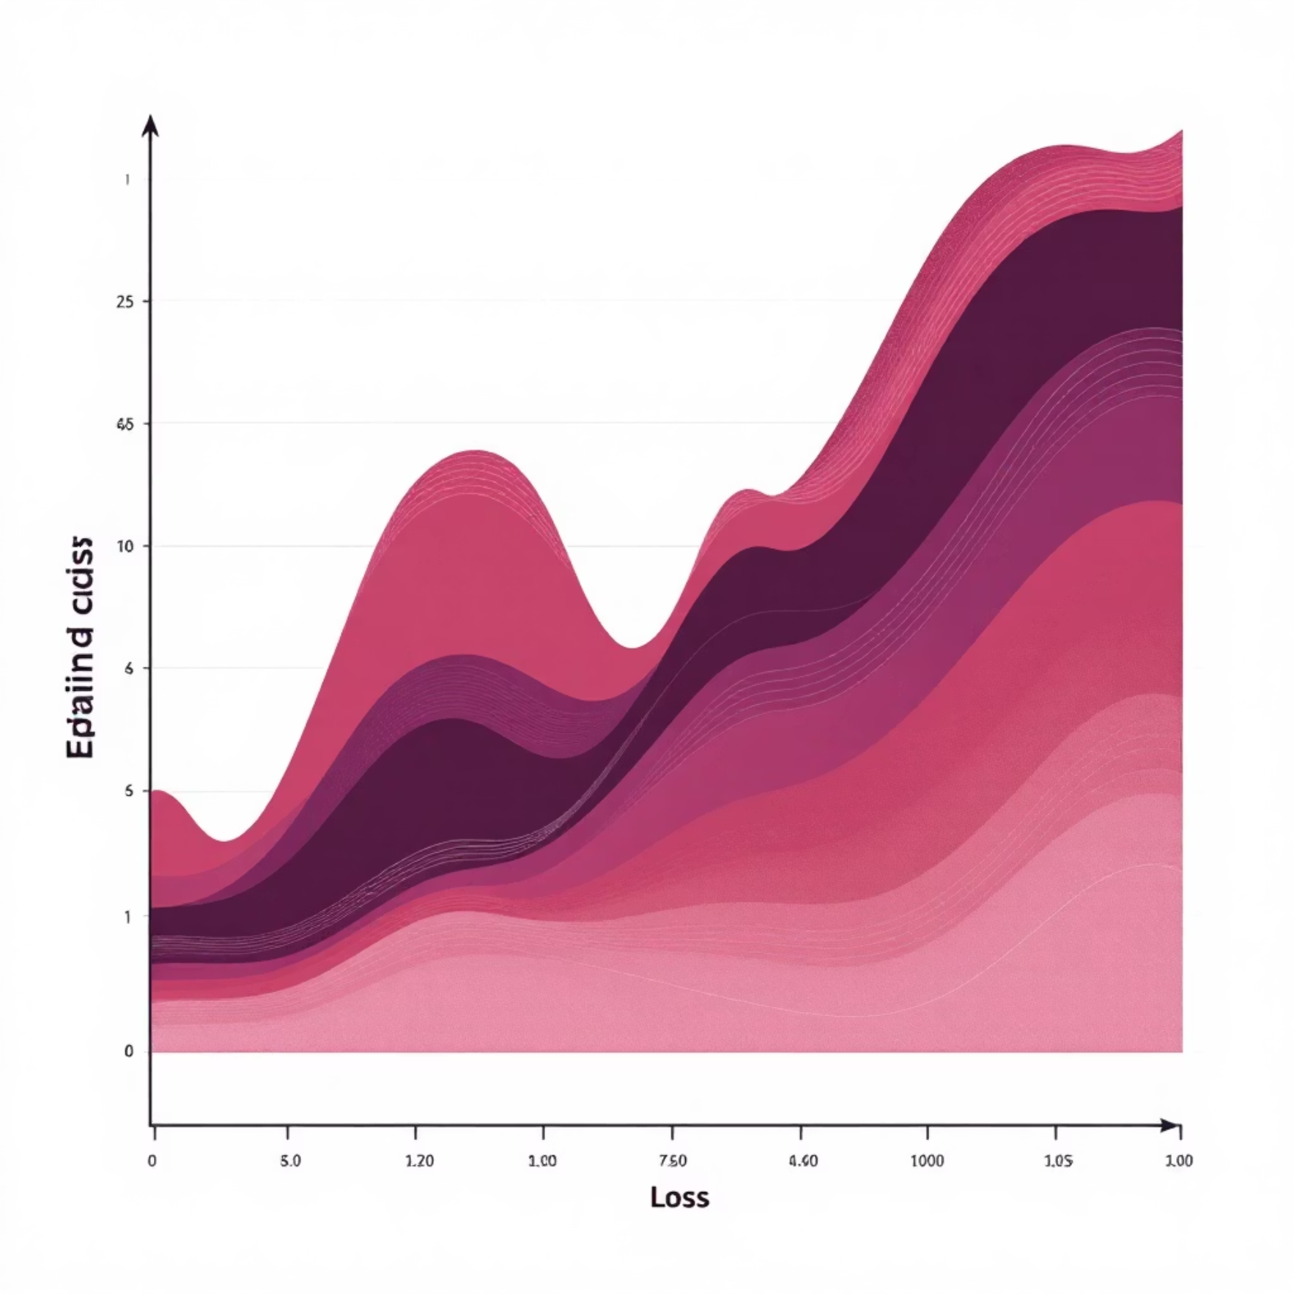


BiLSTM Training Dynamics
Accuracy Progression
Loss Analysis
Training accuracy increased steadily throughout epochs, demonstrating effective learning of fraudulent posting patterns.
Validation accuracy showed slight fluctuations while loss curves indicated mild overfitting, successfully mitigated by early stopping.
Key Observation: The BiLSTM model demonstrated strong learning capability but required careful regularization. The gap between training and validation performance suggests the model could benefit from additional dropout or data augmentation in future iterations.

Slide 8
Comprehensive Model Comparison
All three models were evaluated across multiple metrics to identify the optimal classifier for detecting fraudulent job postings. F1 Score served as the primary selection criterion, balancing the trade-off between precision and recall.
Model
Accuracy
Precision
Recall
F1 Score
AUC
Logistic Regression
0.9747
0.7120
0.7861
0.7473
0.9707
Random Forest
0.9776
0.9794
0.5491
0.7037
0.9730
BiLSTM
0.9650
0.6600
0.5722
0.6130
0.9063

Slide 9
Model Selection & Deliverables
Winner: Logistic Regression
Milestone-2 Artifacts
File
Description
logreg_best.joblib
Best ML model
logreg_metrics.json
ML performance scores
random_forest_metrics.json
RF evaluation metrics
After comprehensive evaluation, Logistic Regression emerged as the best model with the highest and most balanced F1 Score of 0.7473.
bilstm_model.keras
Deep learning model
tokenizer.pkl
DL tokenizer
Balanced Performance
bilstm_metrics.json
DL performance data
Achieved optimal trade-off between precision (71.2%) and recall (78.6%), ensuring fraudulent postings are detected without excessive false alarms.
Generalization Strength
Demonstrated robust performance without overfitting, making it reliable for real-world deployment scenarios.
Interpretability
Linear model coefficients provide clear insights into which text features indicate fraudulent behavior.

Slide 10


Next Steps: Milestone-3 Deployment
With our trained and validated model ready, Milestone-3 will focus on creating a production-ready system that enables real-time fraud detection for job seekers and platforms.
API Development
Deploy the best model using Flask or FastAPI to create RESTful endpoints for fraud prediction.
Interactive UI
Build an intuitive web interface where users can paste job descriptions and receive instant fraud assessments.
Real-Time Prediction
Integrate saved preprocessing artifacts (vectorizer, tokenizer) for seamless text-to-prediction pipeline with sub-second response times.
Impact: This system will empower job seekers to verify posting legitimacy before applying, reducing fraud exposure and improving trust in online job markets.

